Slide 1
Toxicity Classification Model

Slide 2
Our process
1
2
3
4
Pre trained embedding
Text Preprocessing
Bidirectional
LSTM
Kaggle Submission

Slide 3

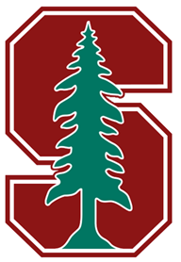
Embedding
FastText crawl 300d 2M
2 million word vectors trained on Common Crawl released by Facebook
glove.840B.300d.txt
Global Vectors for Word Representation. Pre trained word embedding model with 2.2M different words

Slide 4
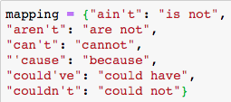
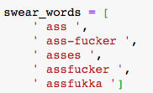
Text Preprocessing
Contraction mapping
Swear words list
Replace swear words list by single word ‘Fuck’.
Lemmatizer to keep: verbs, adjectives, adverbs and nouns.

Slide 5
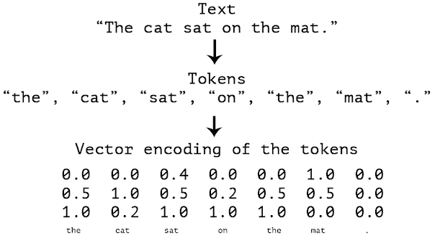
Text Preprocessing
Keras tokenizer for train and test, excluding special characters (‘!"#$%&()*+,-./:;<=>’)
Text to sequences of tokens
Pads sequences to the same length

Slide 6
Bidirectional LSTMs
The idea is to split the state neurons of a regular RNN in a part that is responsible for the positive time direction (forward states) and a part for the negative time direction (backward states)
— Mike Schuster and Kuldip K. Paliwal, Bidirectional Recurrent Neural Networks, 1997

Slide 7
Credits
Kaggle Notebook: Introduction to NLP hust. https://www.kaggle.com/duykhanh99/introduction-to-nlp-hust
GloVe embedding: https://www.kaggle.com/takuok/glove840b300dtxt
FastText Embedding: https://www.kaggle.com/yekenot/fasttext-crawl-300d-2m
Mike Schuster and Kuldip K. Paliwal, Bidirectional Recurrent Neural Networks, 1997

Slide 8
Thanks!
Any questions?

